Slide 1
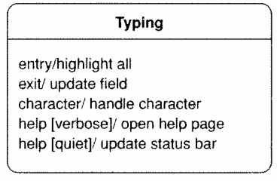
Internal activities
internal activity: actions that the central object takes on itself
sometimes drawn as self-transitions (events that stay in same state)
entry/exit activities
reasons to start/stop being in that state

Slide 2
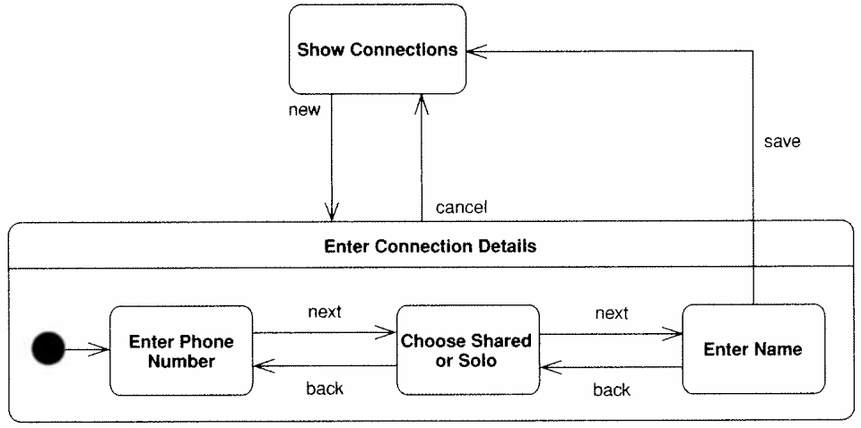
Super/substates
When one state is complex, you can include substates in it.
drawn as nested rounded rectangles within the larger state

Slide 3
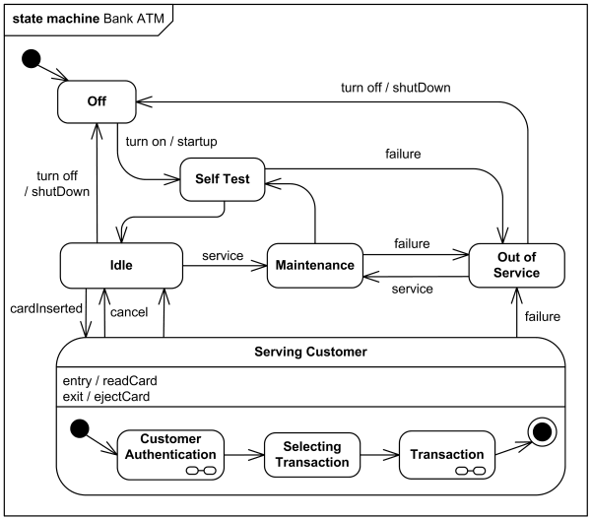
State diagram example
ATM software states at a bank

Slide 4
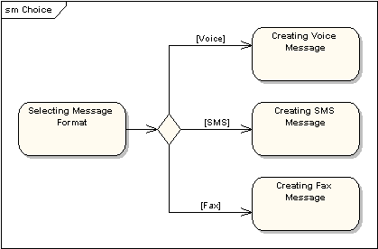
Choice Pseudo-State

Slide 5
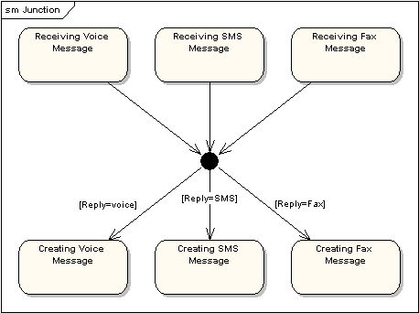
Junction Pseudo-State

Slide 6
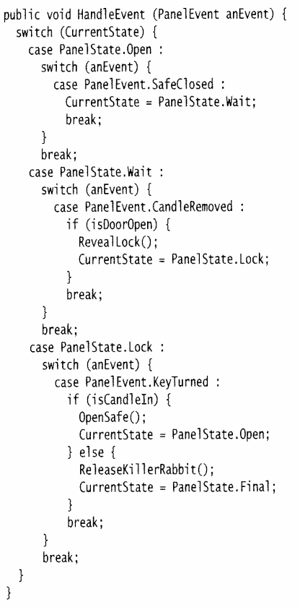
Implementing states
What are some ways to write code to match a state diagram?
state tables (pseudo-code)
nested if/else
switch statements
state enums
State design pattern

Slide 7
State enum example
/** Represents states for a poker game. */
public enum GameState {
NOT_STARTED, IN_PROGRESS, WAITING_FOR_BETS,
DEALING, GAME_OVER;
}
/** Poker game model class. */
public class PokerGame {
private GameState state;
public GameState getState() { return state; }
public void ante(int amount) {
...
state = WAITING_FOR_BETS; // change state
setChanged();
notifyObservers(state);
}
}

Slide 8
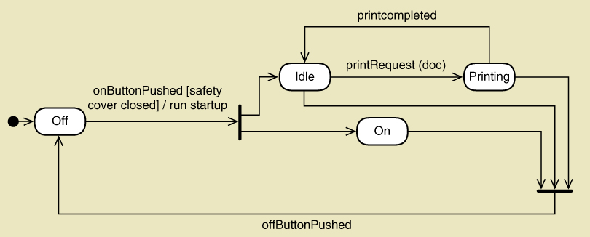
Printer with Concurrent Paths
Concurrent paths often shown by synchronization bars (same as Activity Diagram)
Multiple exits from a state is an “OR” condition.
Multiple exits from a synchronization bar is an “AND” condition.

Slide 9
